Slide 1

Python Working with Feature Data
Ghislain Prince
Danny McVey
2019 ESRI DEVELOPER SUMMIT
Palm Springs, CA
Notes:
G243257 DevSummit 2019 Template for Esri staff

Slide 2

Materials at https://github.com/ghisprince/PythonWorkingWithFeatureDataDS2020

Slide 3
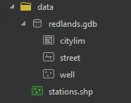
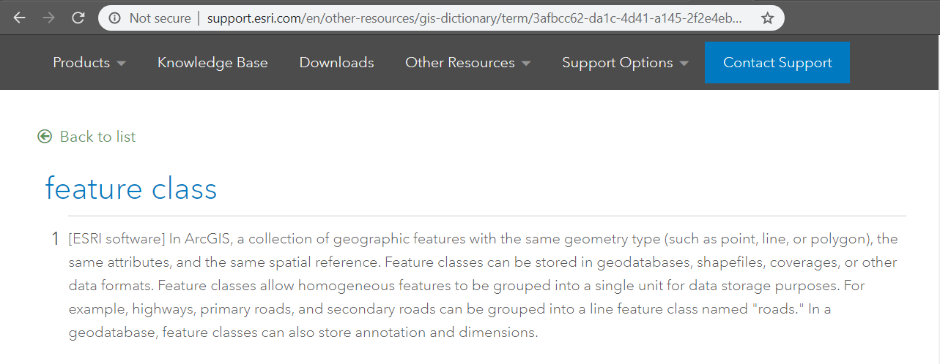


Feature Class basics

Slide 4
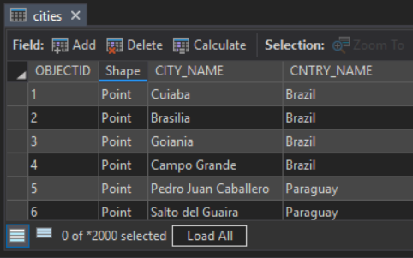
Feature Class basics

Slide 5
arcpy
“ArcPy is a Python site package that provides a useful and productive way to perform geographic data analysis, data conversion, data management, and map automation with Python.”
https://pro.arcgis.com/en/pro-app/arcpy/get-started/what-is-arcpy-.htm

Slide 6
ArcPy in ArcGIS Products
ArcGIS Pro
ArcGIS Desktop (ArcMap)
ArcGIS Engine
ArcGIS Enterprise (both Linux and Windows)
Python 3 runtime for ArcGIS Server on Linux
Hosted Notebooks with ArcPy
ArcGIS Online
Hosted Notebooks (with Advanced license)
Geo AI Data Science Virtual Machine (collaboration with Microsoft)

Slide 7
arcpy
1400+ gp tools
eg.
arcpy.analysis.Buffer
arcpy.conversion.TableToExcel
arcpy.management.Copy
arcpy.na.Solve
arcpy.sa.Aspect
general utilities
describe data properties
list data
data access (table, feature, raster)
operators
modules containing related functionality
arcpy.cim (cartographic information model)
arcpy.da (for data access)
arcpy.metadata
arcpy.nax (network analysis)
arcpy.sharing

Slide 8
Cursors
Cursors provide record-by-record, feature-by-feature access
Basic necessity for many workflows
Two implementations
arcpy.da cursors and “Classic” cursors
Which one? Unless you have legacy code you don’t want to update, use arcpy.da
SearchCursor | Read-only access
UpdateCursor | Update or delete rows
InsertCursor | Insert rows

Slide 9
Cursors
arcpy.da cursors use lists and tuples
Row values are accessed by index
fields = ["CITY_NAME", "POPULATION"]
cursor = arcpy.da.InsertCursor(table, fields)
cursor.insertRow(["Swellview", 20000])

Slide 10
with statements
arcpy.da Cursors support with statements
consistently removes data locks
clear code
also arcpy.da.Editor, arcpy.EnvManager
with arcpy.da.SearchCursor(table, fields) as cursor:
for row in cursor:
# do

Slide 11
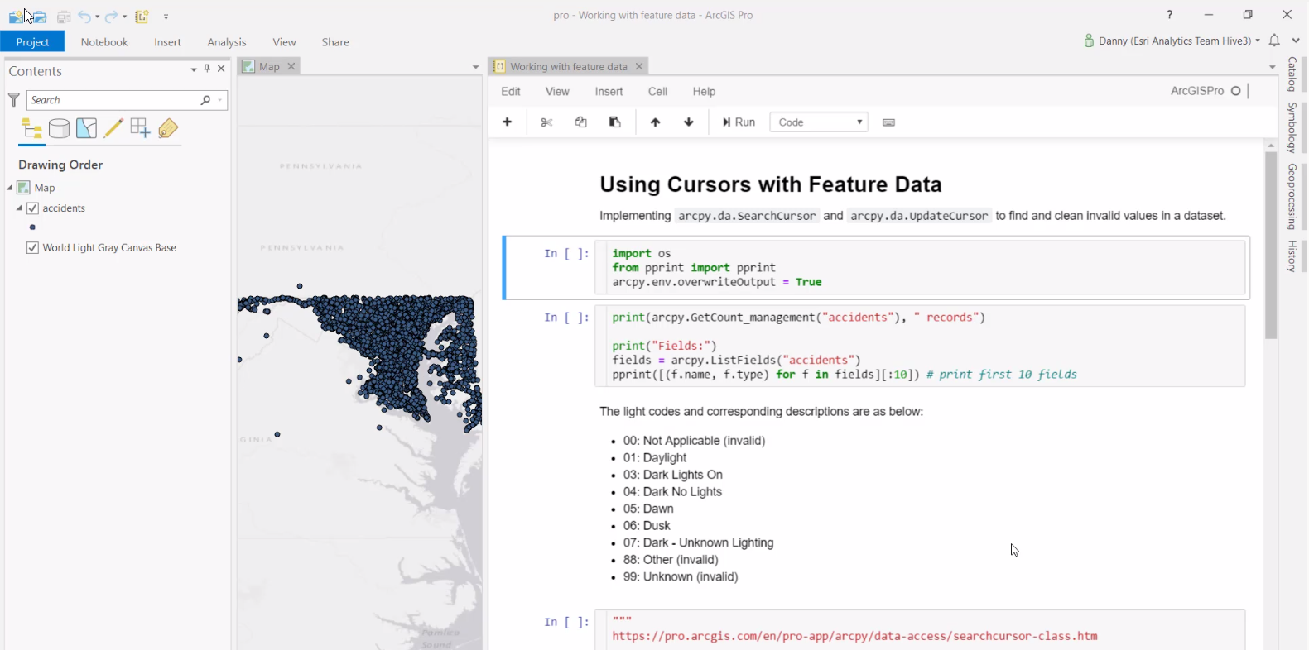



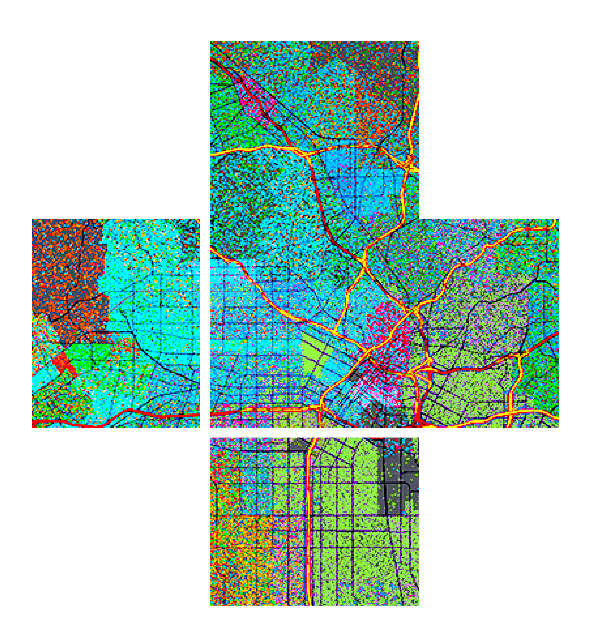


Demo Cursors
Danny

Slide 12
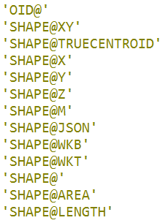
field_names and tokens
Equivalent to using the geometry field name
Specify only the fields you need
star (*) will get you all fields, but is not recommended due to performance cost
Tokens can be also be used
special field types
transformed geometry (for performance - again)

Slide 13
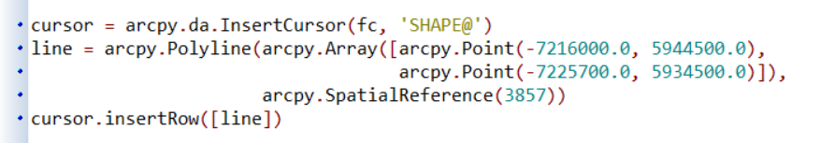
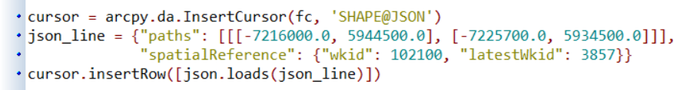
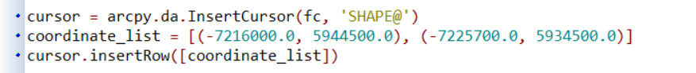
Working with geometry
Many different options for accessing/creating geometry within a cursor
Geometry objects
Esri JSON
List of coordinates
dumps

Slide 14


Data Iterators

Slide 15
Iterating over data
Many processes require cataloging or iterating over data
Common theme are arcpy list functions
ListDatasets | da.ListDomains
ListFeatureClasses | da.ListFieldConflictFilters
ListFields | da.ListReplicas
ListFiles | da.ListSubtypes
ListIndexes | da.ListVersions
ListRasters
ListTables
ListWorkspaces | … more!

Slide 16
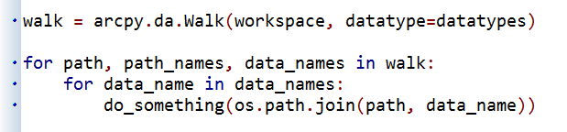
Walk
Traverse a directory structure to find ArcGIS data types
Returns a tuple of three: path, path names, and filenames
Similar pattern to Python’s os.walk

Slide 17
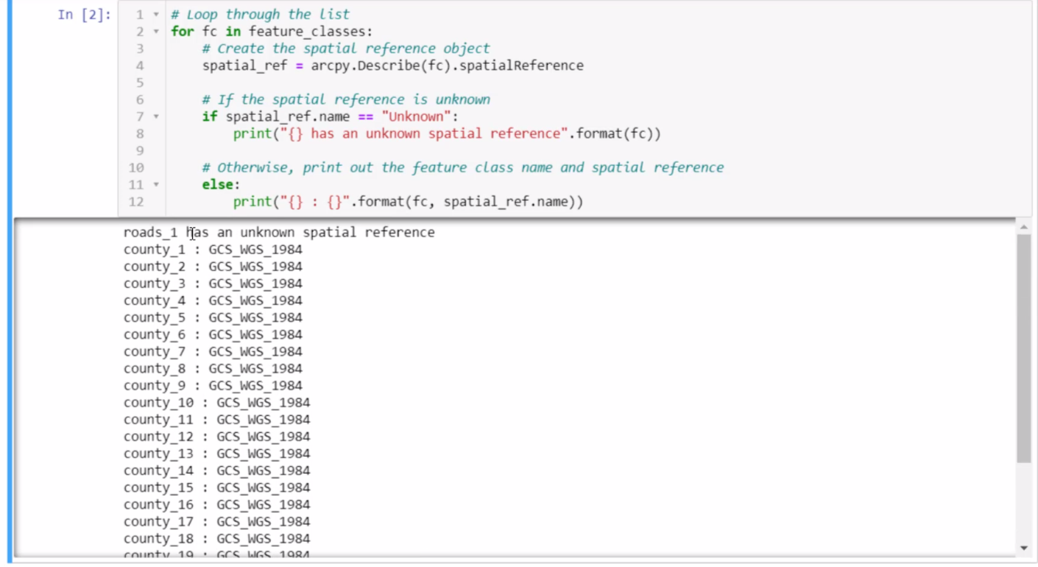
Demo : arcpy.da.Walk
Danny

Slide 18
Interop with External libs

Slide 19
NumPy
NumPy is a 3rd party Python library for scientific computing
A powerful array object
Sophisticated analysis capabilities
arcpy.da supports converting tables and feature classes to/from numpy arrays
FeatureClassToNumPyArray, TableToNumPyArray
Can also converting rasters to/from numpy arrays
RasterToNumPyArray, NumPyArrayToRaster
(found in main arcpy namespace)

Slide 20
NumPy functions
arcpy.da provides additional support for tables and feature classes
Function
FeatureClassToNumPyArray | Convert a feature class to an array
TableToNumPyArray | Convert a table to an array
NumPyArrayToFeatureClass | Convert an array to a Feature Class
NumPyArrayToTable | Convert an array to a Table
ExtendTable | Join an array to a Table

Slide 21
Export to NumPy
Can convert tables and feature classes into numpy arrays for further analysis
https://pro.arcgis.com/en/pro-app/arcpy/data-access/featureclasstonumpyarray.htm
arr = arcpy.da.FeatureClassToNumPyArray(fc, ["INCOME", "POP"])
corr_coef = numpy.corrcoef((arr["INCOME"], arr["POP"])

Slide 22
Import from NumPy
Take the product of your work in numpy and convert it back to ArcGIS
Points only
Polygons, lines, multipoints?
http://esriurl.com/5862
arr = numpy.array([(1, (0.128, 51.507)),
(2, (-74.006, 40.712)],
numpy.dtype([('id_field', numpy.int32),
('XY', '<f8', 2)]))
sr = arcpy.SpatialReference(4326)
arcpy.da.NumPyArrayToFeatureClass(arr, outfc, ['XY'], sr)

Slide 23
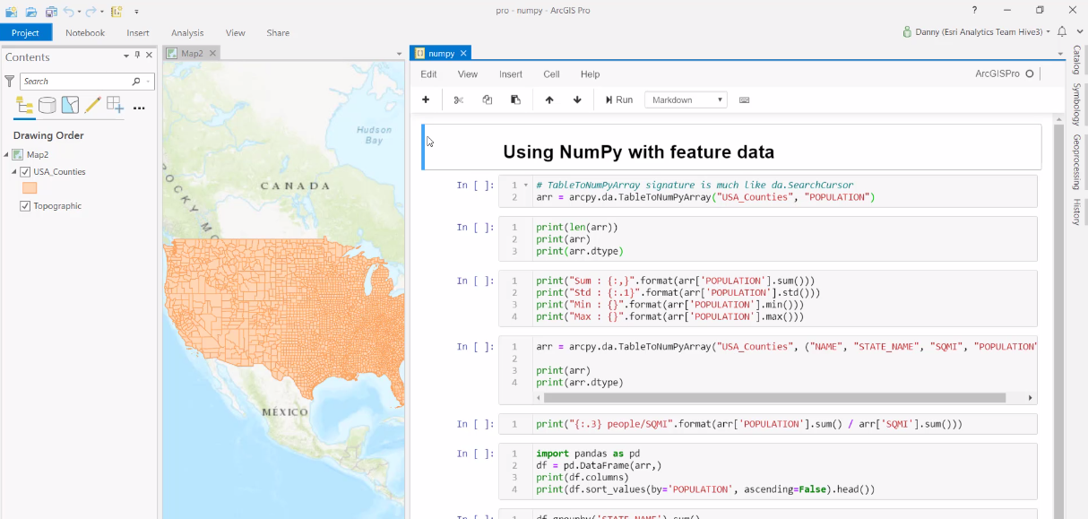
Demo : Numpy and Pandas
Danny

Slide 24
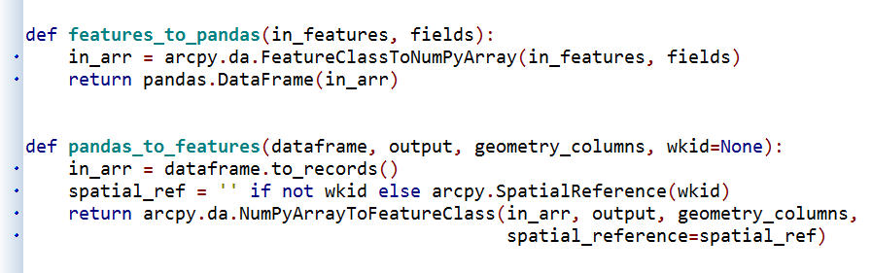
pandas
pandas is 3rd party library known for:
high-performance
easy-to-use data structures and
analysis tools

Slide 25
arcgis api for python
arcgis.features : editing & analyzing feature data
the `Spatially Enabled DataFrame`: a standard pandas DataFrame object + geo-aware
for more see : https://developers.arcgis.com/python/guide/overview-of-the-arcgis-api-for-python/

Slide 26
other presentations
arcgis api for python
"python working with raster data"
data science
esri's python offering keeps expanding

